Slide 1
CSE 2500: Introduction to Discrete Systems
Lecture 20: Probability Part 2
Kaleel Mahmood
Department of Computer Science and Engineering
University of Connecticut

Slide 2
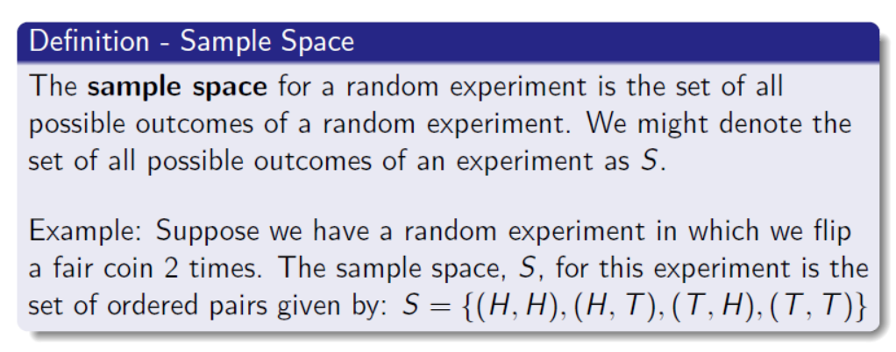
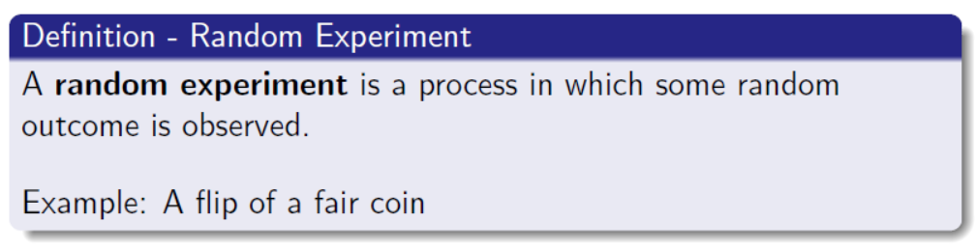
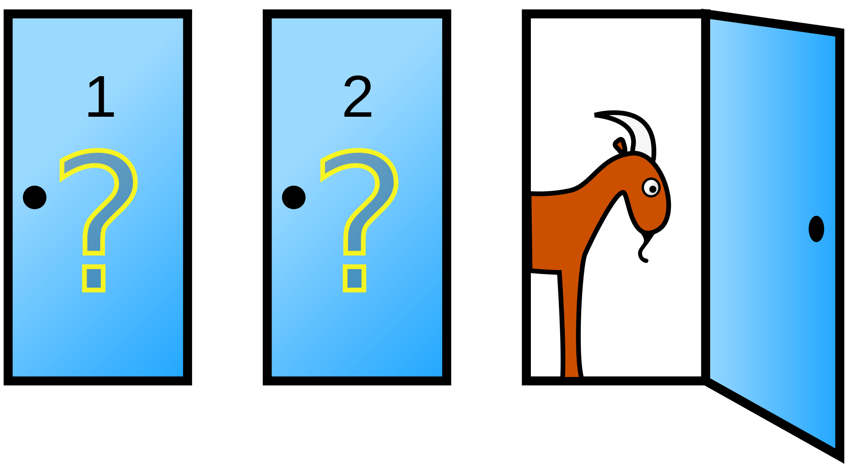
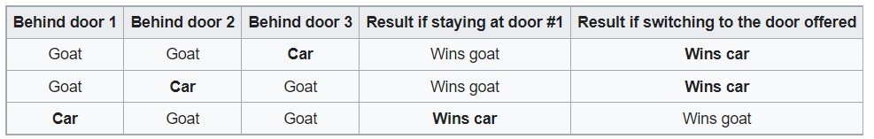
Review From Last Lecture
The Monty Hall Problem

Slide 3

A quick aside: What is the difference between probability and statistics?
The problems considered by probability and statistics are inverse to each other.
In probability theory we consider some underlying process which has some randomness or uncertainty modeled by random variables, and we try to predict what will happen.
In statistics we observe something that has happened, and try to figure out what underlying process would explain those observations.
statistics
probability
Source: https://stats.stackexchange.com/questions/665/whats-the-difference-between-probability-and-statistics

Slide 4
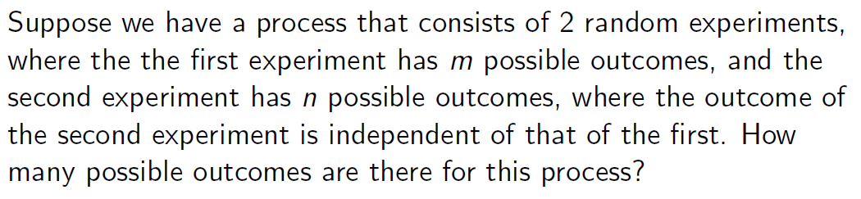
A Process with Multiple Random Experiments
$$number of outcomes=m×n$$

Slide 5
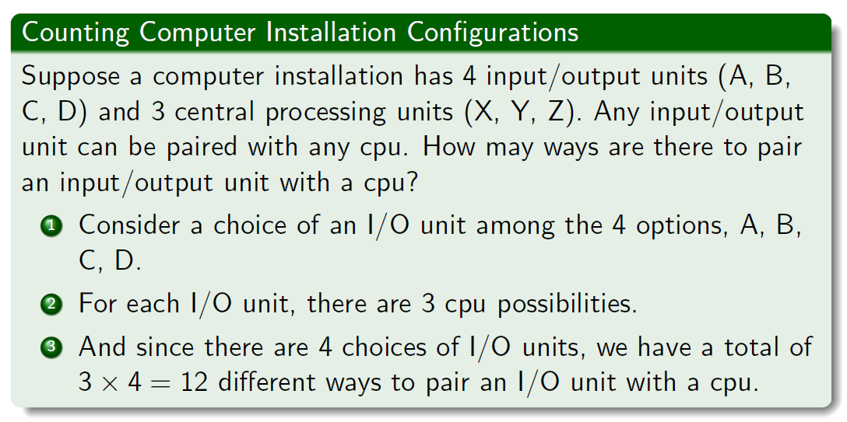

Slide 6
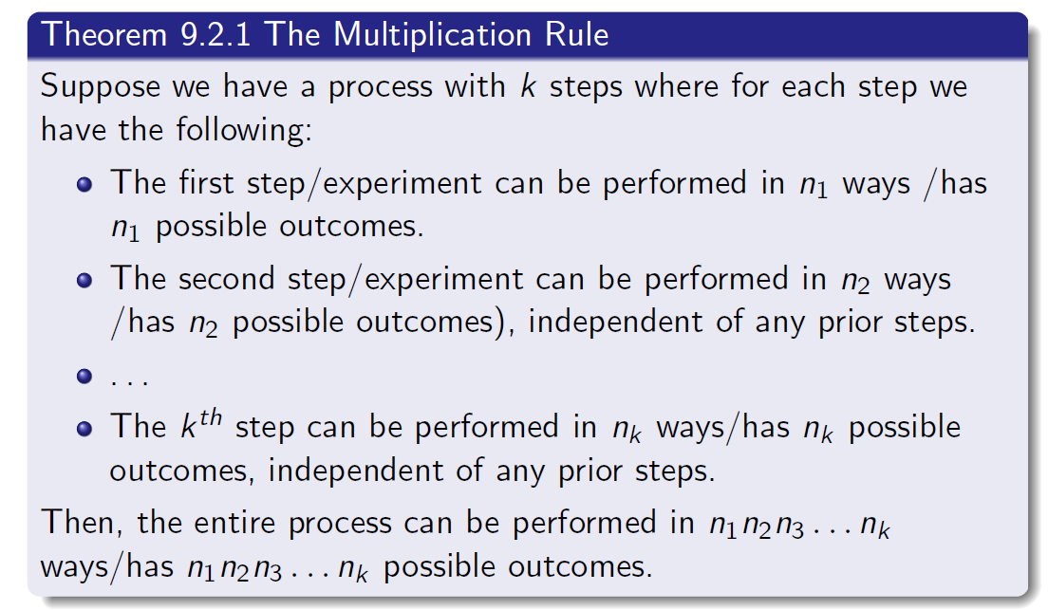

Slide 7
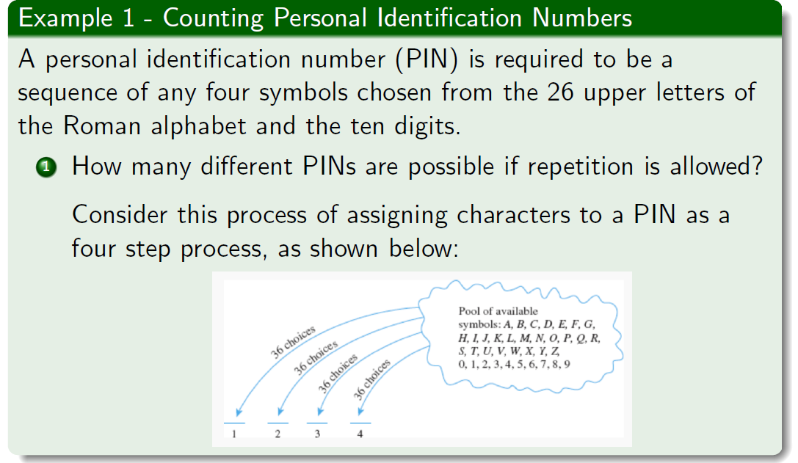

Slide 8
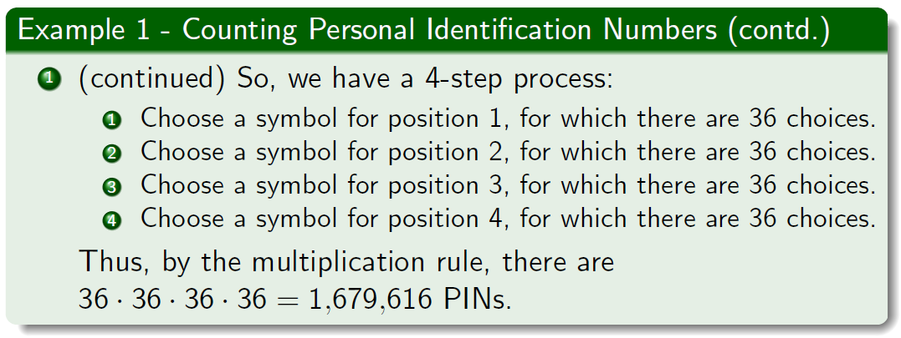
But what if repetition is not allowed?

Slide 9
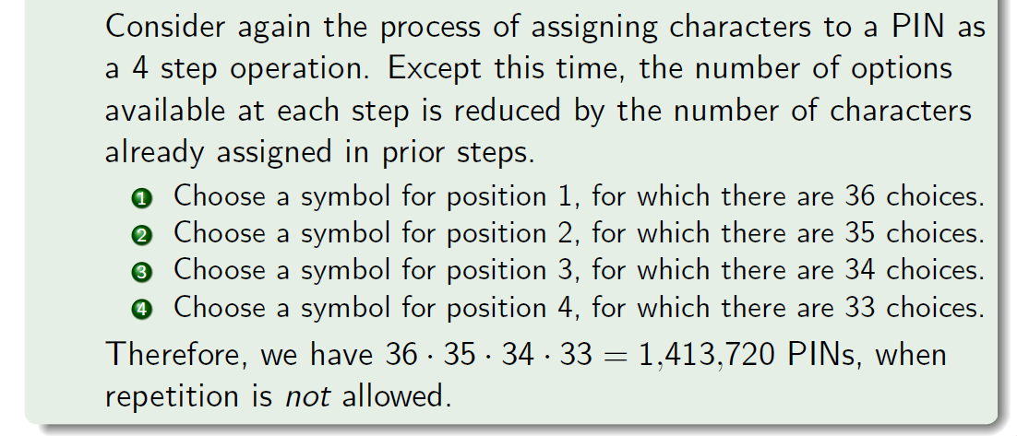
But what if repetition is not allowed?

Slide 10
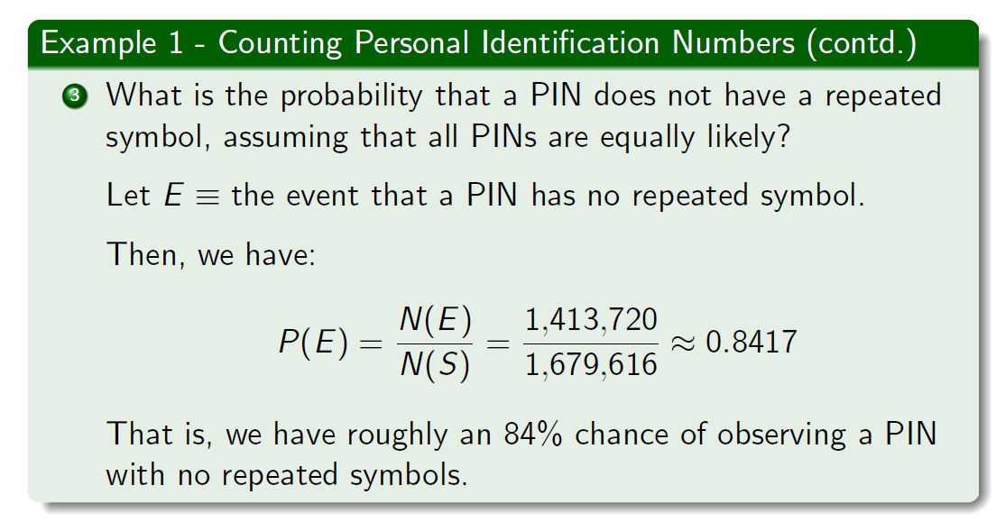

Slide 11
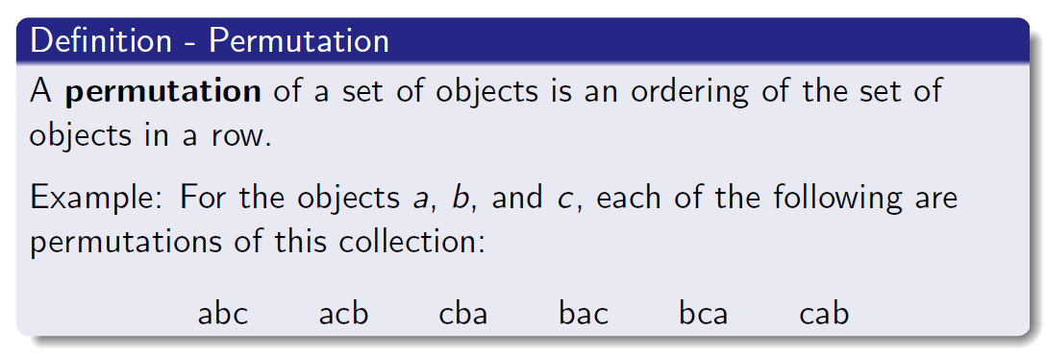
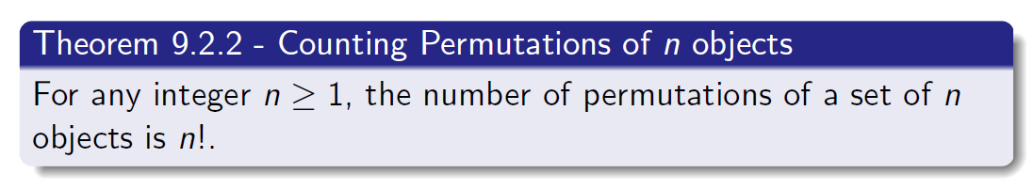

Slide 12
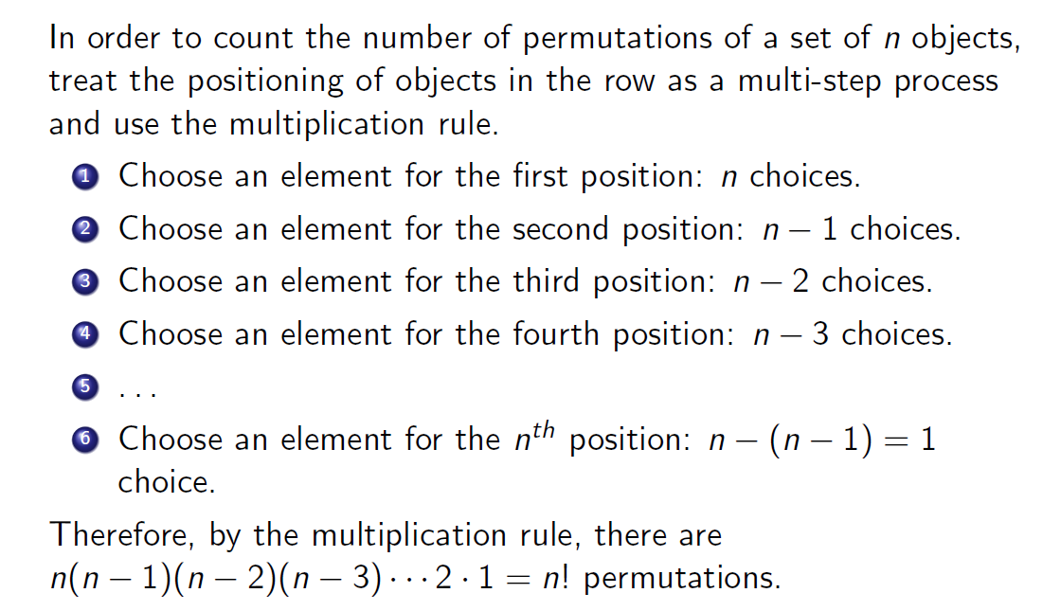

Slide 13
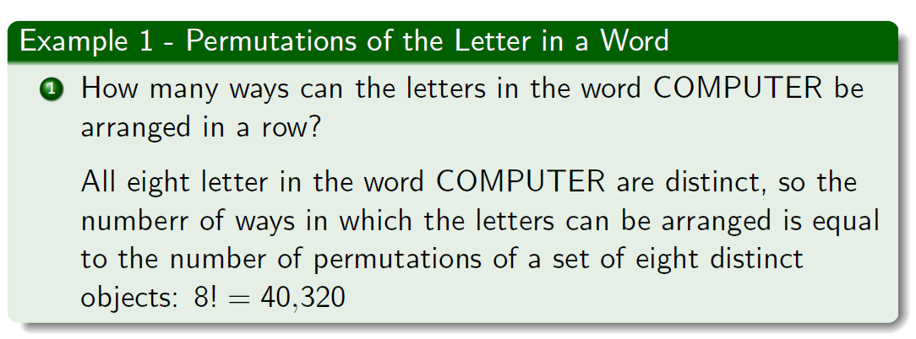
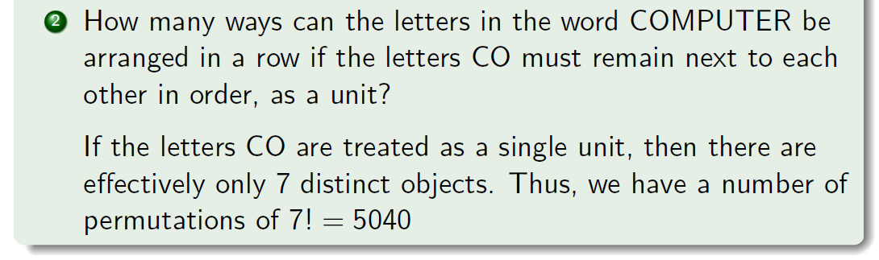

Slide 14
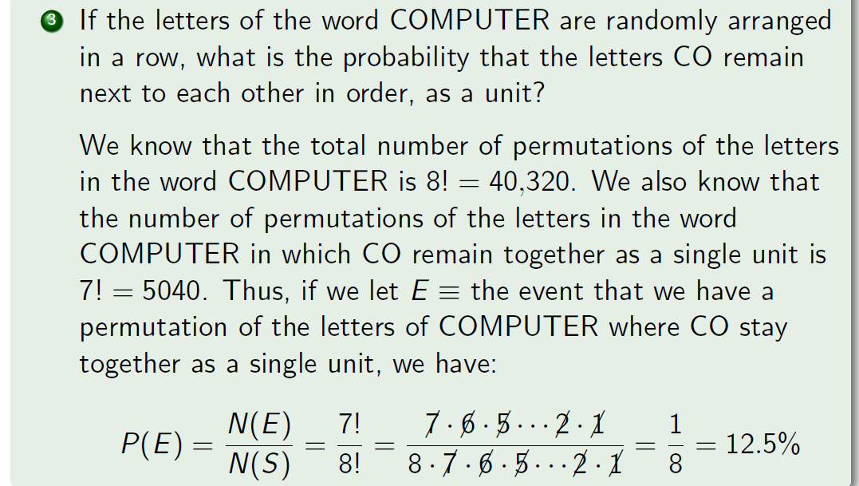

Slide 15
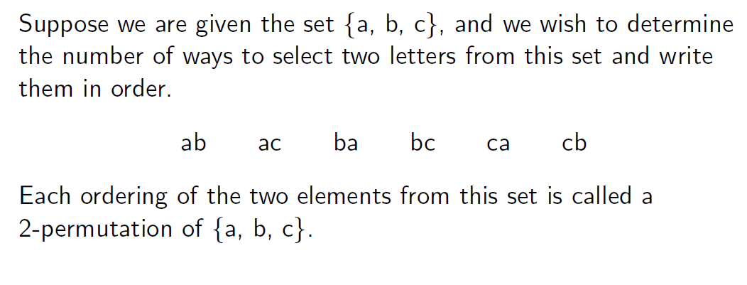
Permutations of r Elements Selected from n objects

Slide 16
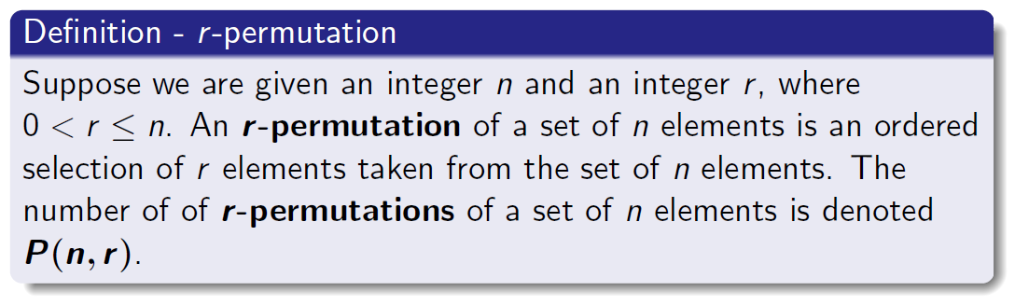
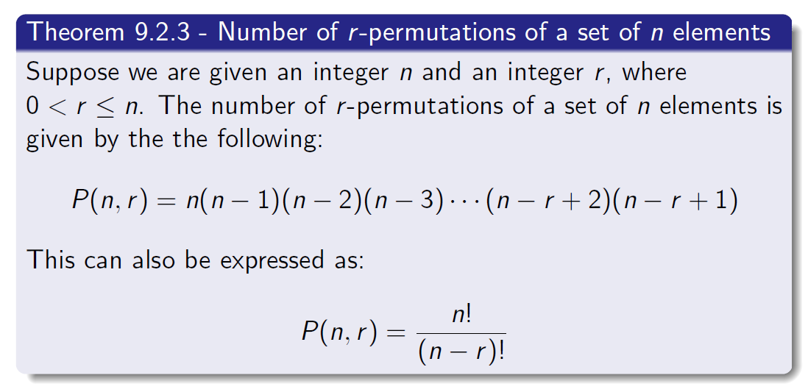

Slide 17
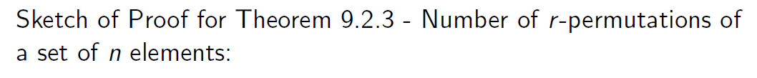
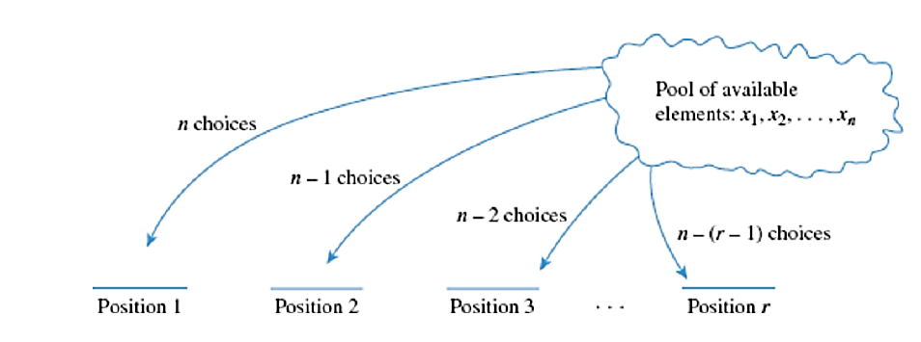

Slide 18
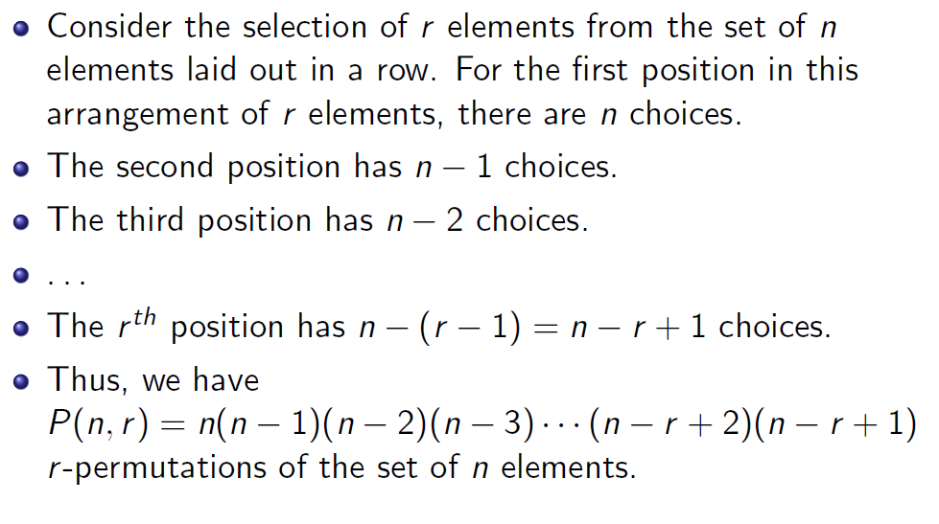

Slide 19
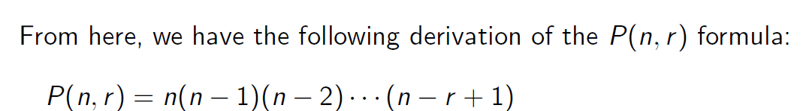
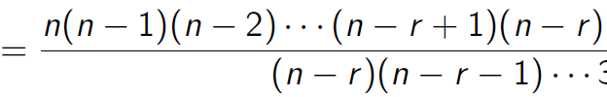
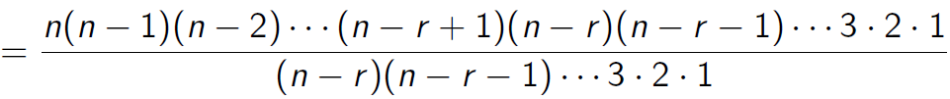
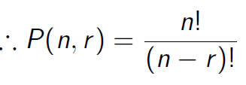
Multiply top and bottom by $(n−r)$:
Multiply top and bottom by $(n−r−1)$ and then $(n−r−2)$ and so on:
So the top is $n!$ And the bottom is $\left(n−r\right)!$

Slide 20
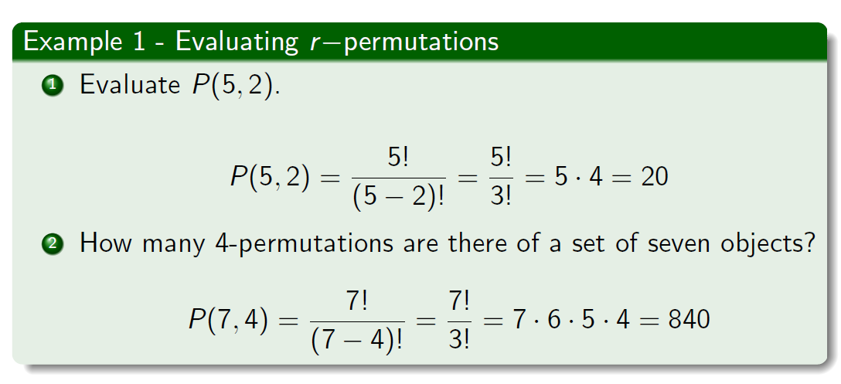
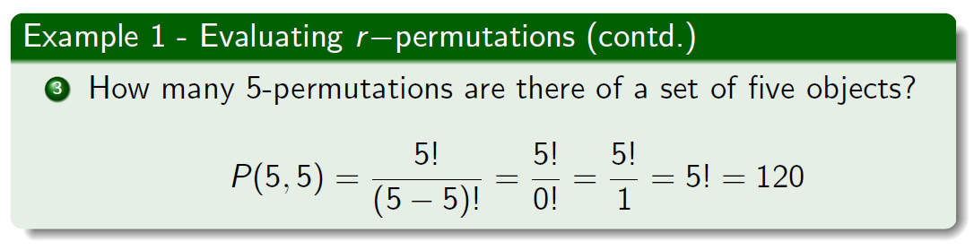

Slide 21
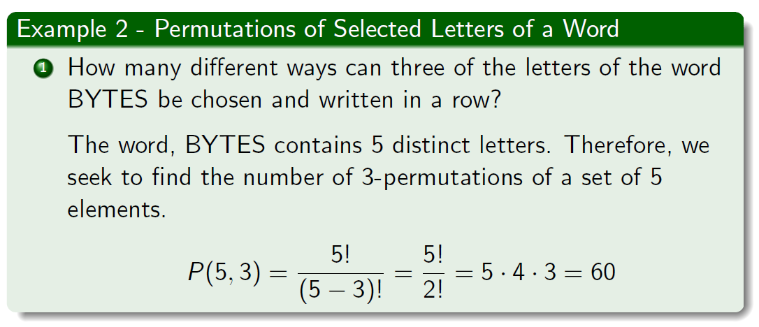
Some more examples…

Slide 22
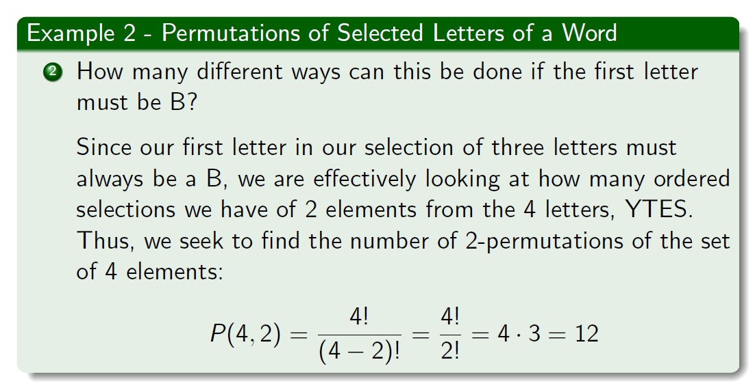

Slide 23
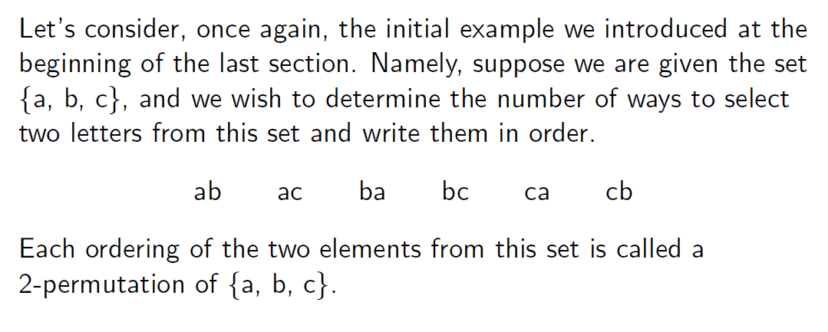
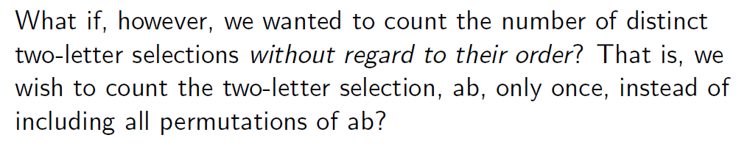

Slide 24
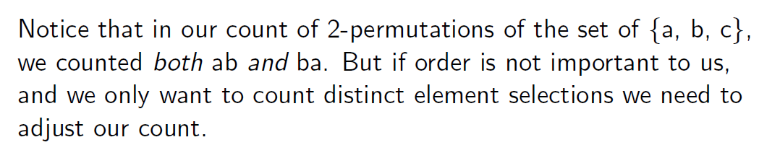

Slide 25
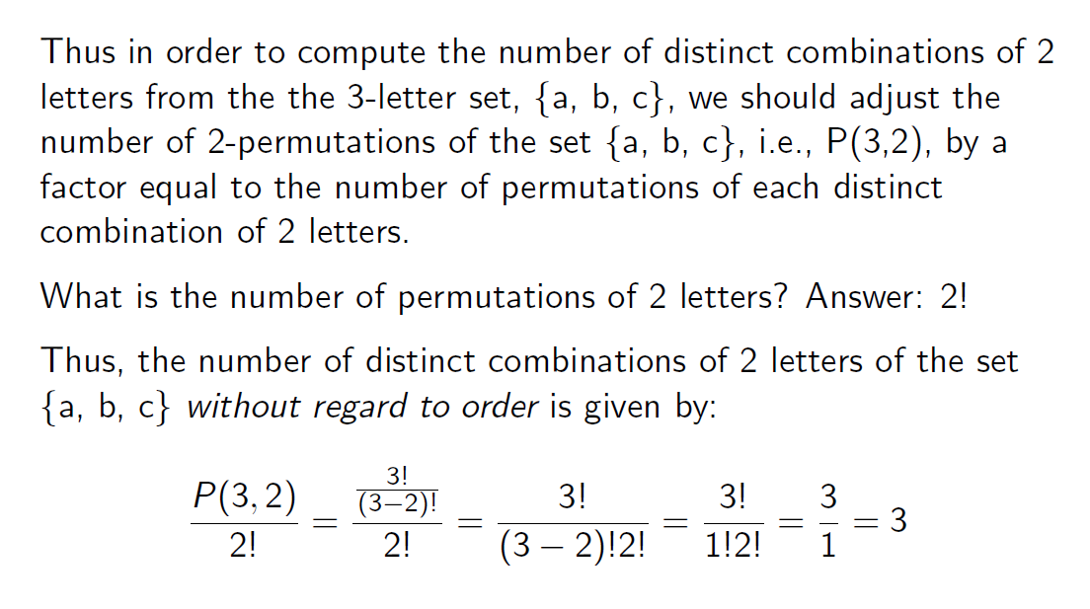

Slide 26
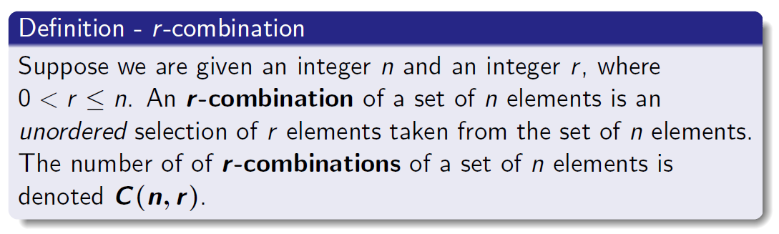
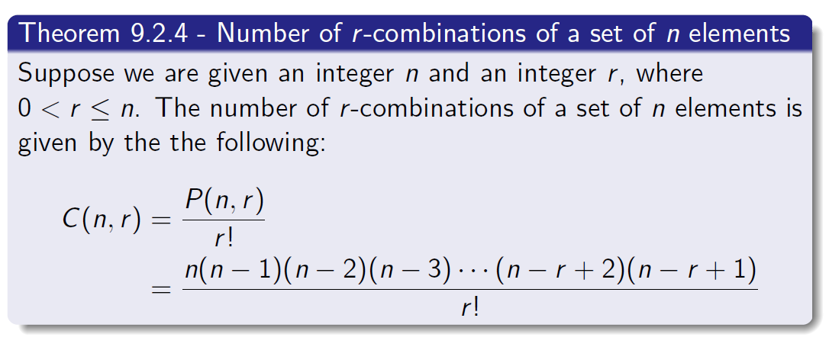

Slide 27
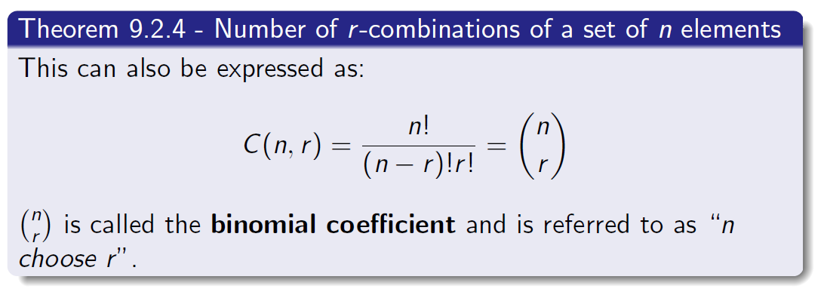

Slide 28
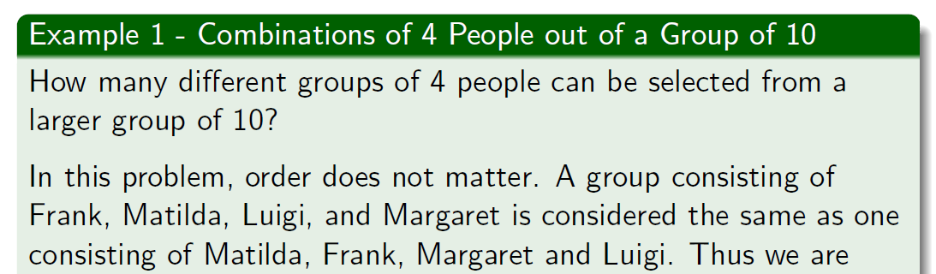
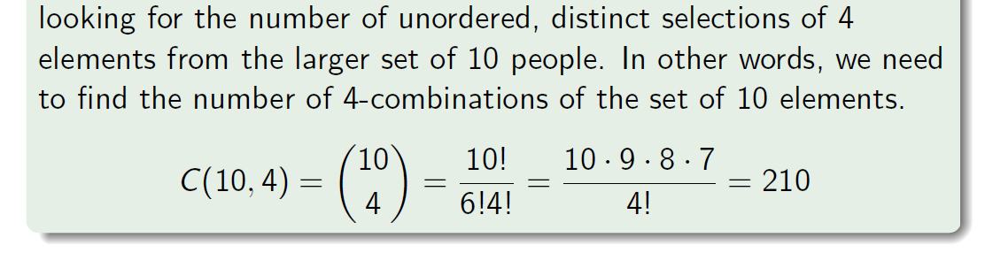

Slide 29
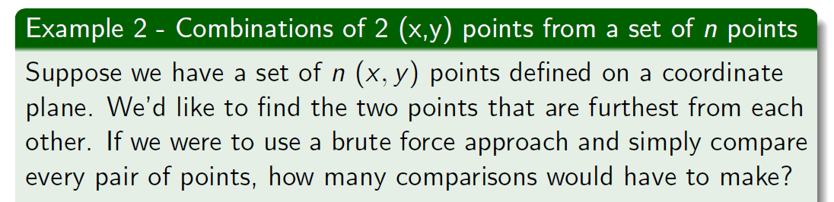
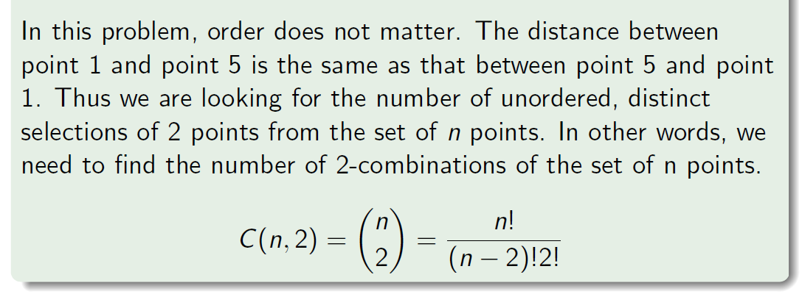

Slide 30


And now it’s time to go to MIT.
Correction: Go to the MIT slides

Slide 31
Random Variables and Functions
Random variable X assigns a number to each outcome:
X : Ω → R
“X = a” denotes the event {ω | X (ω) = a}.
Probability mass function (pmf ) of X is given by:
p(a) = P (X = a).
Cumulative distribution function (cdf ) of X is given by:
F (a) = P (X ≤ a).
Source: https://ocw.mit.edu/courses/18-05-introduction-to-probability-and-statistics-spring-2014/pages/class-slides/

Slide 32
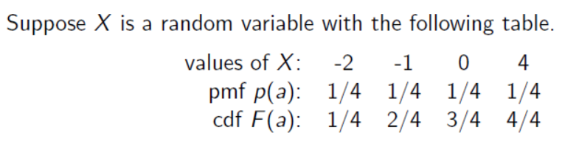
What is a Probability Distribution?
Probability Distribution = The mathematical function that gives the probabilities of occurrence of different possible outcomes for an experiment [1].
In this course we’ll only discuss discrete random variables (i.e. the random variable has a finite number of possible values).
What is the probability X=0? What is the probability $X≤0$?
[1] Everitt, Brian (2006). The Cambridge dictionary of statistics (3rd ed.). Cambridge, UK: Cambridge University Press. ISBN 978-0-511-24688-3. OCLC 161828328

Slide 33
Probability Distribution Example
What is the probability X=0?
Hint: We need to use the pmf

Slide 34

Probability Distribution Example
What is the probability $X≤0$?
Hint: We need to use the cdf

Slide 35

Why do we need probability distributions?
“On August 18, 1913, at the casino in Monte Carlo, black came up a record twenty-six times in succession [in roulette].
[There] was a near-panicky rush to bet on red, beginning about the time black had come up a phenomenal fifteen times.
In application of the maturity [of the chances] doctrine, players doubled and tripled their stakes, this doctrine leading them to believe after black came up the twentieth time that there was not a chance in a million of another repeat. In the end the unusual run enriched the Casino by some millions of francs.”

Slide 36
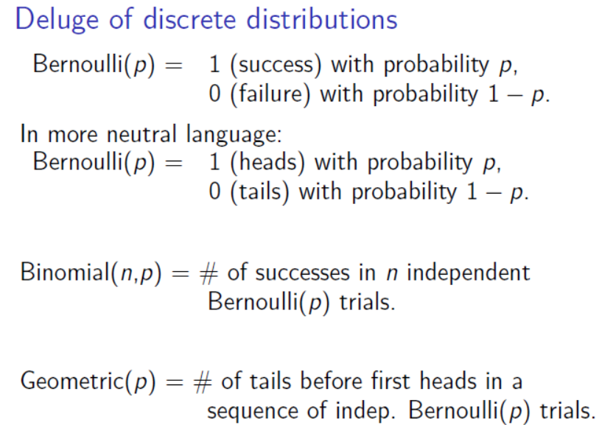
Want to model some event where there are two possible outcomes. E.g. Flipping a coin.
Want to model multiple events where each time there are two possible outcomes. E.g. Flipping a coin multiple times.

Slide 37
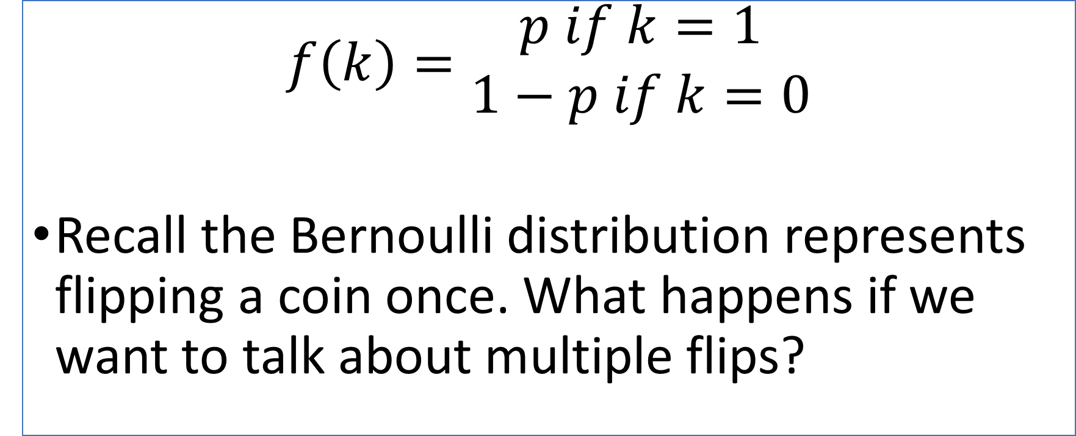
PMF of the Bernoulli Distribution
$$f\left(k\right)=\begin{matrix}p if k=1 \\ 1−p if k=0\end{matrix}$$
Recall the Bernoulli distribution represents flipping a coin once. What happens if we want to talk about multiple flips?

Slide 38
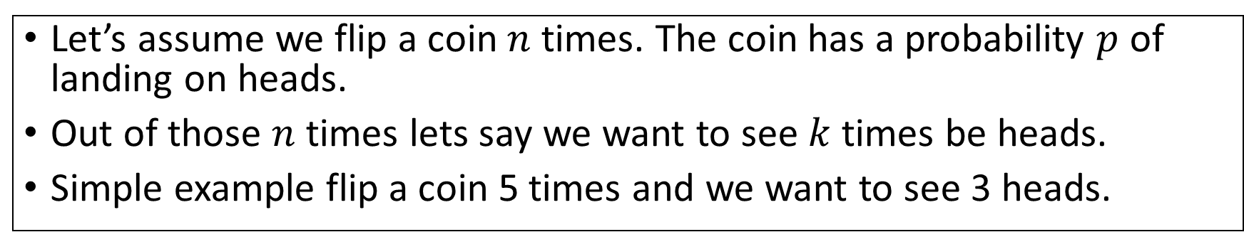
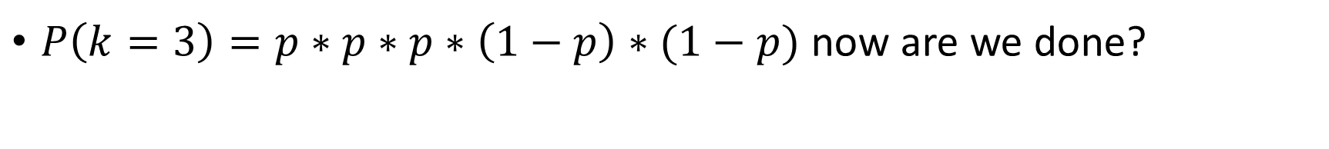
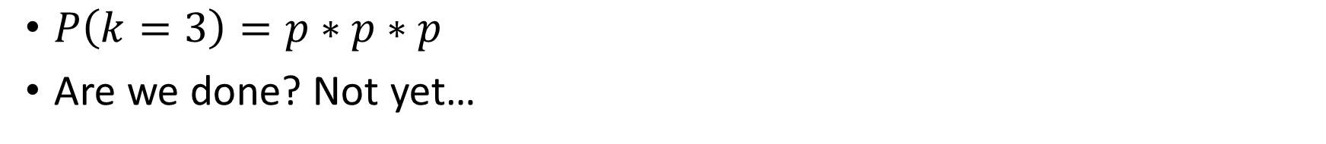
Bernoulli Distribution to Binomial
Let’s assume we flip a coin $n$ times. The coin has a probability $p$ of landing on heads.
Out of those $n$ times lets say we want to see $k$ times be heads.
Simple example flip a coin 5 times and we want to see 3 heads.
$P\left(k=3\right)=p∗p∗p$
Are we done? Not yet…
$P\left(k=3\right)=p∗p∗p∗\left(1−p\right)∗(1−p)$ now are we done?
We only considered the probability of getting three heads when the first three flips are heads. But could we also have H-H-T-T-H?

Slide 39
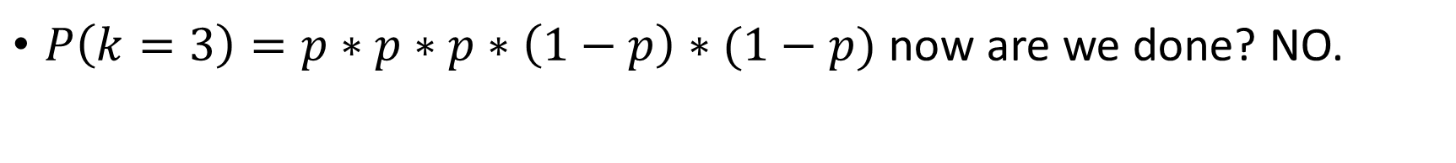
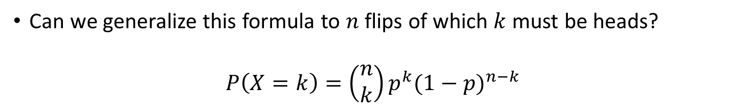

Bernoulli Distribution to Binomial
$P\left(k=3\right)=p∗p∗p∗\left(1−p\right)∗(1−p)$ now are we done? NO.
We only considered the probability of getting three heads when the first three flips are heads. But could we also have H-H-T-T-H?
Recall our combinations slide…we have 5 flips, of those 3 must be heads ( 5 choose 3).
$P\left(k=3\right)=\frac{5!}{\left(5−3\right)!3!}∗p∗p∗p∗\left(1−p\right)∗(1−p)$
Can we generalize this formula to $n$ flips of which $k$ must be heads?
$$P\left(X=k\right)=\left(\begin{matrix}n \\ k\end{matrix}\right)p^{k}{(1−p)}^{n−k}$$

Slide 40


Back to the Casino Problem…
The gamblers saw black come up 15 times in a row (only two choices black and red).
Let’s say that in this problem black is equally as likely as red $(p=0.5)$. What is the probability of seeing black 16 times in a row (and no red)?
Well $n=16$ and $k=16$
$P\left(X=k\right)=\left(\begin{matrix}n \\ k\end{matrix}\right)p^{k}{(1−p)}^{n−k}$
$$P\left(X=16\right)=\left(\begin{matrix}16 \\ 16\end{matrix}\right){(0.5)}^{16}{(1−0.5)}^{0}=\frac{1}{65,536}$$

Slide 41

Back to the Casino Problem…2
$P\left(X=16\right)=\left(\begin{matrix}16 \\ 16\end{matrix}\right){(0.5)}^{16}{(1−0.5)}^{0}=\frac{1}{65,536}$
We see that the probability of getting black 16 times in a row is quite low. Does that mean we should bet on red?
Well let us ask the following question. What is the probability of getting 15 blacks in a row and then one red?
Here it is important to note that we can’t use the original binomial formula with n choose k, why?
Because of the key word “in a row”, if we use the binomial pmf that computes the answer for different sequences, not necessarily in a row.

Slide 42

Back to the Casino Problem…3
$P\left(B=15, R=1\right)$ (Order Matters, red must come last)
$p^{15}∗{(1−p)}^{1}$ since we know that $0.5$ then this simply becomes:
${(0.5)}^{16}=\frac{1}{65,536}$
Thinking that an event is more likely based on past events when the events are statistical INDEPENDENT from one another is called the gambler’s fallacy.

Slide 43
Casino Problem Conclusions
We saw that the probability of two specific sequences (15 black and 1 red) as opposed to (16 black) are equally likely.
Its important to understand when events are linked and effect one another (and when events are independent).
We can see that some conclusions make intuitive sense (e.g. it is more likely to get red on the next roll after seeing so many black). However it is important to use probability theory to analyze their accuracy.
Extra food for thought: How would you design a simulation in Python to test the gamblers fallacy?

Slide 44
Figure Sources
https://gdb.voanews.com/2DAA72F0-CF5B-4D84-B996-8351DF7C1193_cx0_cy6_cw0_w1080_h608.jpg
https://upload.wikimedia.org/wikipedia/commons/thumb/0/0d/Sim%C3%A9onDenisPoisson.jpg/800px-Sim%C3%A9onDenisPoisson.jpg
https://cdn.britannica.com/27/190027-050-A9A35298/Carl-Friedrich-Gauss-engraving.jpg
https://upload.wikimedia.org/wikipedia/commons/thumb/a/ab/Florence_Nightingale_%28H_Hering_NPG_x82368%29.jpg/800px-Florence_Nightingale_%28H_Hering_NPG_x82368%29.jpg
https://upload.wikimedia.org/wikipedia/commons/1/1a/Crystal_Project_computer.png
https://herway.net/wp-content/uploads/2020/03/Confused-Man-8-Reasons-For-His-Uncertainty-And-How-To-Deal-With-It.jpg
https://theawesomedaily.com/wp-content/uploads/2020/04/puts-on-sunglasses-feat-1-1.jpg
https://cdn.vox-cdn.com/thumbor/mFiywP9BUHDC8AIRBDYJvXdfQiA=/1400x1050/filters:format(jpeg)/cdn.vox-cdn.com/uploads/chorus_asset/file/23265504/Spider_Man_meme.jpg
https://i.ytimg.com/vi/elmZ-SFw5a4/maxresdefault.jpg
https://1000logos.net/wp-content/uploads/2022/08/MIT-Logo.png
https://ocw.mit.edu/courses/18-05-introduction-to-probability-and-statistics-spring-2014/pages/class-slides/
https://focusgn.com/wp-content/uploads/2020/08/monte-carlo-casino-introduces-digital-french-roulette-600x400.jpg

